Slide 1



Slide 2



Slide 3
Learning HTML involves...

Slide 4
Learning a list of elements
Learning how these elements are used
Notes:
Explain: Learning HTML means learning all of the elements that you can use.

Slide 5
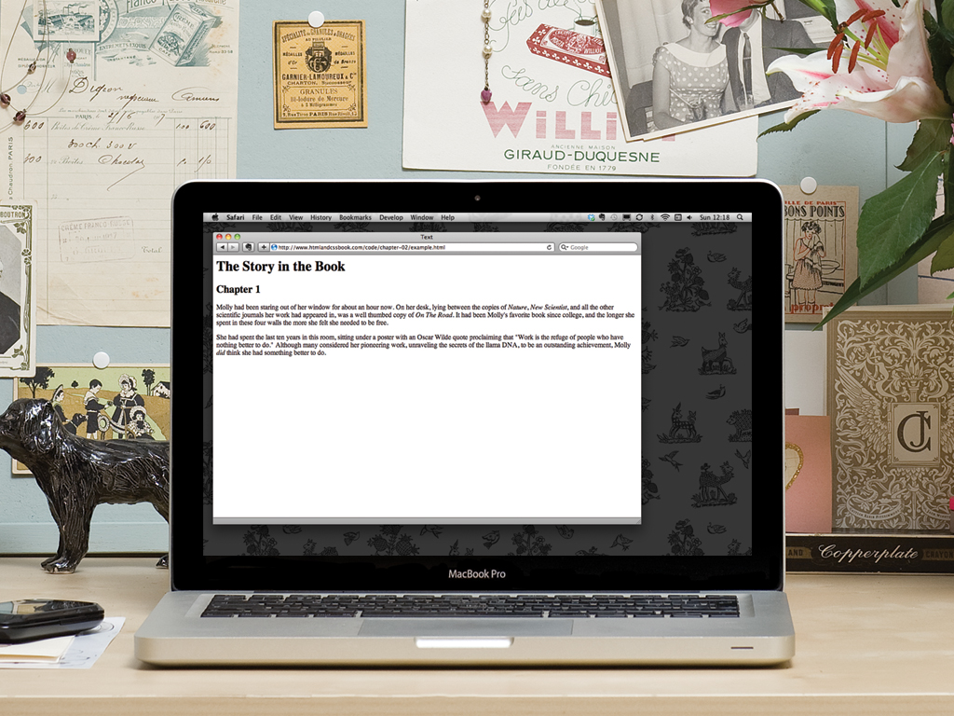
TAGS DESCRIBE CONTENT
Creating a page involves adding tags to content

Slide 6
TAGS DESCRIBE CONTENT
These tags are known as "markup"
Notes:
Explain: Tags are referred to as "markup".

Slide 7
There are two types of markup...

Slide 8
STRUCTURAL
SEMANTIC

Slide 9
HEADINGS
<h1>This is a Main Heading</h1>
<h2>This is a level 2 heading</h2>
<h3>This is a level 3 heading</h3>
<h4>This is a level 4 heading</h4>
<h5>This is a level 5 heading</h5>
<h6>This is a level 6 heading</h6>
Notes:
Explain: There are six levels of heading. <h1> is shown the largest and <h6> is shown the smallest. The "h" in the tag name stands for the word "heading".

Slide 10
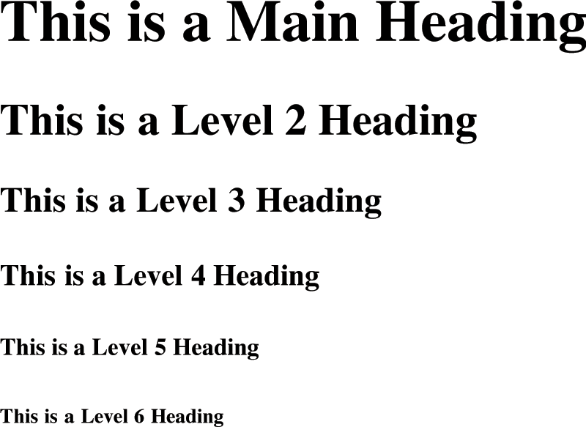

Slide 11
PARAGRAPHS
<p>A paragraph consists of one or more sentences that form a self-contained unit of discourse. The start of a paragraph is indicated by a new line.</p>
<p>Text is easier to understand when it is split up into units of text. For example, a book may have chapters. Chapters can have subheadings. Under each heading will be one or more paragraphs.</p>
Notes:
Explain: The <p> tag is used for paragraphs of text. You now have basic structure of headings and paragraphs of text. This is another example of how the letters in the tags describe the purpose of the tag. That is, the "p" in this tag stands for the word "paragraph".

Slide 12
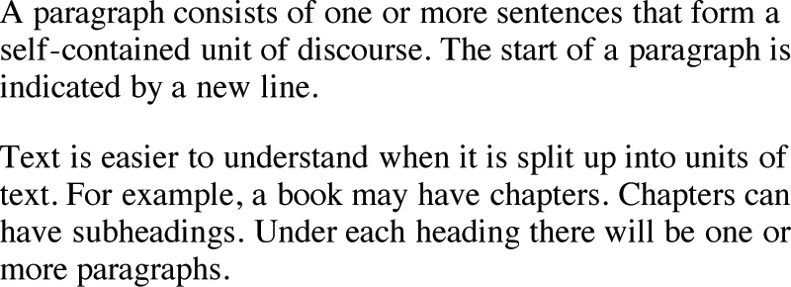

Slide 13
BOLD & ITALIC
<p>This is how we make a word appear <b>bold</b>.</p>
<p>This is how we make a word appear <i>italic</i>.</p>
Notes:
Please note: The <strong> and <em> tags are described in a later section talking about semantic markup. It can be confusing to introduce this too early as beginners are more familiar with concepts of bold and italic.

Slide 14
BOLD & ITALIC
<p>This is how we make a word appear <b>bold</b>.</p>
<p>This is how we make a word appear <i>italic</i>.</p>

Slide 15
BOLD & ITALIC
<p>This is how we make a word appear <b>bold</b>.</p>
<p>This is how we make a word appear <i>italic</i>.</p>

Slide 16
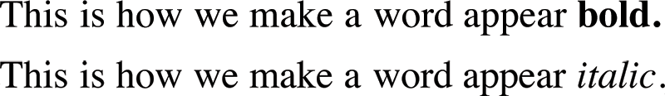

Slide 17
SUPERSCRIPT & SUBSCRIPT
<p>On the 4<sup>th</sup> September you will learn about E=MC<sup>2</sup>.</p>
<p>The amount of C0<sub>2</sub> in the atmosphere grew by 2ppm in
2009<sub>1</sub>.</p>

Slide 18
SUPERSCRIPT & SUBSCRIPT
<p>On the 4<sup>th</sup> September you will learn about E=MC<sup>2</sup>.</p>
<p>The amount of C0<sub>2</sub> in the atmosphere grew by 2ppm in
2009<sub>1</sub>.</p>

Slide 19
SUPERSCRIPT & SUBSCRIPT
<p>On the 4<sup>th</sup> September you will learn about E=MC<sup>2</sup>.</p>
<p>The amount of C0<sub>2</sub> in the atmosphere grew by 2ppm in
2009<sub>1</sub>.</p>

Slide 20
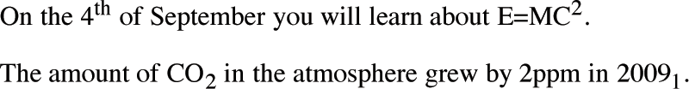

Slide 21
WHITESPACE IS COLLAPSED
<p>The moon is
drifting away from the
earth.</p>
Notes:
Explain: Multiple spaces get collapsed into a single space. (As students will see later, this allows you to add space into code to make it more readable.)

Slide 23
LINE BREAKS
<p>The Earth<br />gets one hundred tons heavier every day<br />due to falling space dust.</p>
Notes:
Explain: This tag is not to be used to separate paragraphs. That is what the <p> element is for.

Slide 24
LINE BREAKS
<p>The Earth<br />gets one hundred tons heavier every day<br />due to falling space dust.</p>

Slide 25
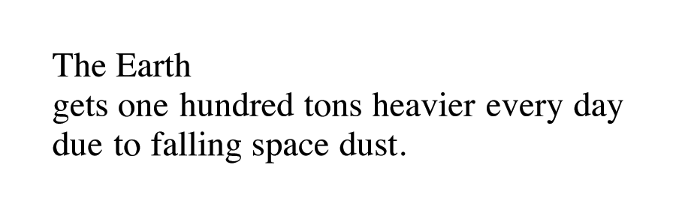

Slide 26
HORIZONTAL RULES
<p>Venus is the only plant that rotates clockwise</p>
<hr />
<p>Jupiter is bigger than all the other planets combined.</p>

Slide 27
HORIZONTAL RULES
<p>Venus is the only plant that rotates clockwise</p>
<hr />
<p>Jupiter is bigger than all the other planets combined.</p>

Slide 28
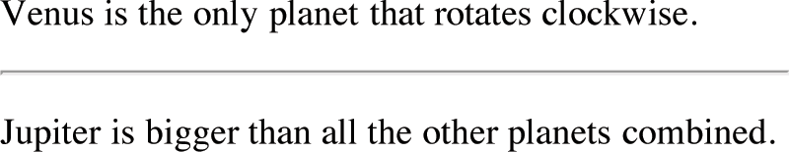

Slide 29
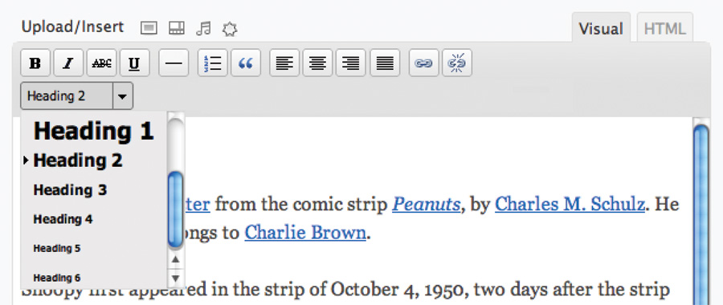
VISUAL EDITORS &
THEIR CODE VIEWS
Notes:
Explain: This is a WYSIWYG editor. WYSIWYG stands for "What You See Is What You Get". These are commonly used in content management systems and blogging tools.

Slide 30
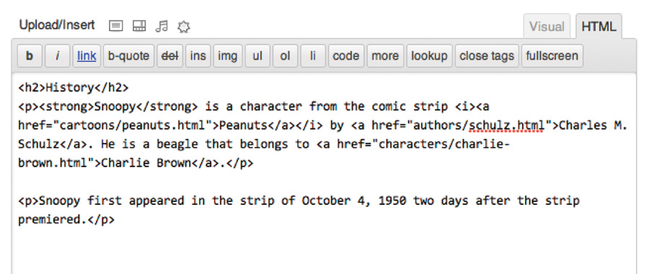
VISUAL EDITORS &
THEIR CODE VIEWS
Notes:
Explain: There is often an HTML editor that sits alongside the WYSIWIG editor, so you can edit the source code directly.

Slide 31
SEMANTIC MARKUP
WHAT IS IT?
WHY USE IT?
APPLICATION
Set of elements, for example:
The <em> tag adds emphasis
<blockquote>
contains a quote
Provides extra information about your content
Do NOT use it to alter presentation of those elements
Screen readers can add emphasis to words in <em>
Search engines can find quotations in <blockquote>
Notes:
Explain: Some elements add semantic information about the document.
Click: What is semantic markup?
Click: Why use semantic markup (note not to be used just for visual effect)
Click: Examples of how this markup could be used

Slide 32
STRONG & EMPHASIS
<p><strong>Beware</strong> pickpockets operate in this area.</p>
<p>I <em>think</em> Ivy was the first.</p>
<p>I think <em>Ivy</em> was the first.</p>
<p>I think Ivy was the <em>first</em>.</p>

Slide 33
STRONG & EMPHASIS
<p><strong>Beware</strong> pickpockets operate in this area.</p>
<p>I <em>think</em> Ivy was the first.</p>
<p>I think <em>Ivy</em> was the first.</p>
<p>I think Ivy was the <em>first</em>.</p>

Slide 34
STRONG & EMPHASIS
<p><strong>Beware</strong> pickpockets operate in this area.</p>
<p>I <em>think</em> Ivy was the first.</p>
<p>I think <em>Ivy</em> was the first.</p>
<p>I think Ivy was the <em>first</em>.</p>
Notes:
Suggestion: Read the emphasis out. This will help students understand how emphasis is added in different places to change meaning.
Note: Screen readers can add appropriate emphasis to voicing to help convey meaning.
Tip: Saying the sentence out loud helps you determine whether use of these elements is appropriate or not.

Slide 35
STRONG & EMPHASIS
<p><strong>Beware</strong> pickpockets operate in this area.</p>
<p>I <em>think</em> Ivy was the first.</p>
<p>I think <em>Ivy</em> was the first.</p>
<p>I think Ivy was the <em>first</em>.</p>

Slide 36
STRONG & EMPHASIS
<p><strong>Beware</strong> pickpockets operate in this area.</p>
<p>I <em>think</em> Ivy was the first.</p>
<p>I think <em>Ivy</em> was the first.</p>
<p>I think Ivy was the <em>first</em>.</p>

Slide 37
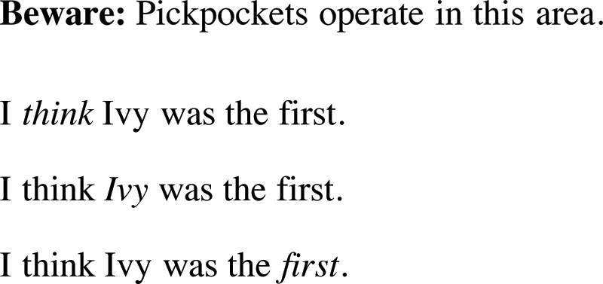

Slide 38
QUOTATIONS
<blockquote
cite="http://en.wikipedia.org/wiki/
Winnie-the-Pooh">
<p>Did you ever stop to think, and
forget to start again?</p>
</blockquote>
<p>As A.A. Milne said, <q>Some people talk
to animals. Not many listen though.
That's the problem.</q></p>

Slide 39
QUOTATIONS
<blockquote
cite="http://en.wikipedia.org/wiki/
Winnie-the-Pooh">
<p>Did you ever stop to think, and
forget to start again?</p>
</blockquote>
<p>As A.A. Milne said, <q>Some people talk
to animals. Not many listen though.
That's the problem.</q></p>

Slide 40
QUOTATIONS
<blockquote
cite="http://en.wikipedia.org/wiki/
Winnie-the-Pooh">
<p>Did you ever stop to think, and
forget to start again?</p>
</blockquote>
<p>As A.A. Milne said, <q>Some people talk
to animals. Not many listen though.
That's the problem.</q></p>

Slide 41
QUOTATIONS
<blockquote
cite="http://en.wikipedia.org/wiki/
Winnie-the-Pooh">
<p>Did you ever stop to think, and
forget to start again?</p>
</blockquote>
<p>As A.A. Milne said, <q>Some people talk
to animals. Not many listen though.
That's the problem.</q></p>

Slide 42
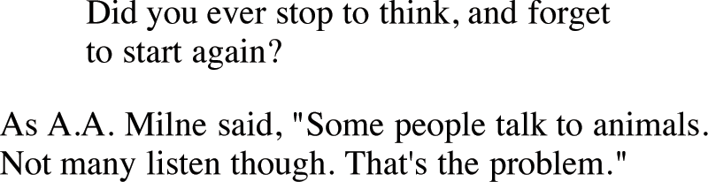

Slide 43
ABBREVIATIONS & ACRONYMS
<p><abbr title="Professor">Prof</abbr>
Stephen Hawking is a theoretical
physicist and cosmologist.</p>
<p><acronym title="National Aeronautics
and Space Administration">NASA</acronym>
do some crazy space stuff.</p>

Slide 44
ABBREVIATIONS & ACRONYMS
<p><abbr title="Professor">Prof</abbr>
Stephen Hawking is a theoretical
physicist and cosmologist.</p>
<p><acronym title="National Aeronautics
and Space Administration">NASA</acronym>
do some crazy space stuff.</p>

Slide 45
ABBREVIATIONS & ACRONYMS
<p><abbr title="Professor">Prof</abbr>
Stephen Hawking is a theoretical
physicist and cosmologist.</p>
<p><acronym title="National Aeronautics
and Space Administration">NASA</acronym>
do some crazy space stuff.</p>
Notes:
Note: The <acronym> tag has been dropped from HTML5 (which just uses <abbr>).

Slide 46
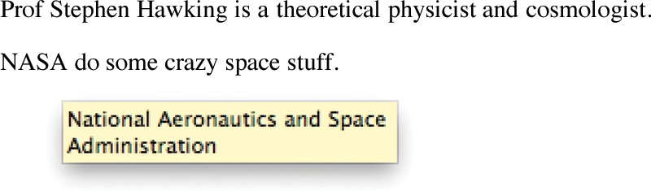

Slide 47
CITATIONS & DEFINITIONS
<p><cite>A Brief History of Time</cite> by
Stephen Hawking has sold over ten million
copies worldwide.</p>
<p>A <dfn>black hole</dfn> is a region
of space from which nothing, note even
light, can escape.</p>

Slide 48
CITATIONS & DEFINITIONS
<p><cite>A Brief History of Time</cite> by
Stephen Hawking has sold over ten million
copies worldwide.</p>
<p>A <dfn>black hole</dfn> is a region
of space from which nothing, note even
light, can escape.</p>

Slide 49
CITATIONS & DEFINITIONS
<p><cite>A Brief History of Time</cite> by
Stephen Hawking has sold over ten million
copies worldwide.</p>
<p>A <dfn>black hole</dfn> is a region
of space from which nothing, note even
light, can escape.</p>

Slide 50
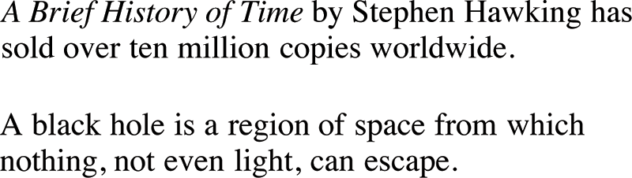

Slide 51
AUTHOR DETAILS
<address>
<p><a href="homer@example.org">
homer@example.org</a></p>
<p>742 Evergreen Terrace, Springfield</p>
</address>
Notes:
Note: This tag is for the author of a given web page only, not for general address details. (For those, coders may use microformats.)

Slide 52
AUTHOR DETAILS
<address>
<p><a href="homer@example.org">
homer@example.org</a></p>
<p>742 Evergreen Terrace, Springfield</p>
</address>

Slide 53
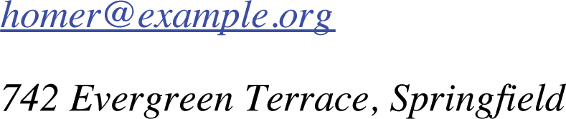

Slide 54
CHANGES TO CONTENT
<p>It was the <del>worst</del>
<ins>best</ins> idea she had ever
had.</p>
<p>Laptop computer:</p>
<p><s>Was $995</s></p>
<p>Now only $375</p>
Notes:
Explain: None of these tags are to be used just for visual effect. CSS offers that option.
Note: There was a <u> element in older versions of HTML.

Slide 55
CHANGES TO CONTENT
<p>It was the <del>worst</del>
<ins>best</ins> idea she had ever
had.</p>
<p>Laptop computer:</p>
<p><s>Was $995</s></p>
<p>Now only $375</p>

Slide 56
CHANGES TO CONTENT
<p>It was the <del>worst</del>
<ins>best</ins> idea she had ever
had.</p>
<p>Laptop computer:</p>
<p><s>Was $995</s></p>
<p>Now only $375</p>

Slide 57
CHANGES TO CONTENT
<p>It was the <del>worst</del>
<ins>best</ins> idea she had ever
had.</p>
<p>Laptop computer:</p>
<p><s>Was $995</s></p>
<p>Now only $375</p>
Notes:
Explain: This tag is not really for content that was supposed to be deleted.

Slide 58
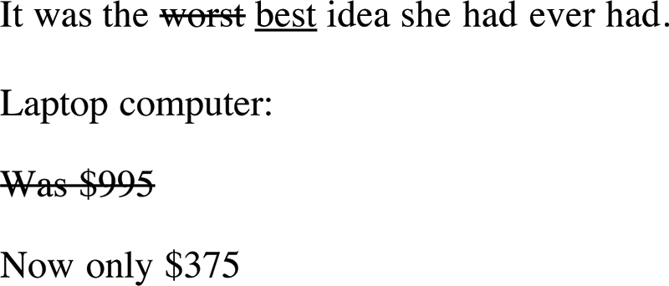

Slide 59
SUMMARY
HTML elements are used to describe the structure of the page (e.g. headings, subheadings, paragraphs).
Notes:
Clicks: Load individual bullets

Slide 60
SUMMARY
They also provide semantic information (e.g. where emphasis is placed, definitions of acronyms, when text is a quotation).
Notes:
Clicks: Load individual bullets

Slide 62


